Slide 1

HOTEL RESERVATION
DIYA Pk
Data Analyst
17/1/2025

Slide 2
OBJECTIVE
The objective of this project is to develop a machine learning model that predicts the likelihood of a hotel reservation being canceled based on the features included in the dataset.
OVERVIEW STEPS
Selecting dataset
Data preprocessing
Modul building
Modul evaluation

Slide 3
CHOOSING A DATASET
The dataset used for this project is the "Hotel reservation" dataset from Kaggle and chatGTP
DESCRIPTION
The dataset includes generated samples for booking status, with each sample including values for arrival year, booking id ,meal plans ,arrival time, arrival year etc. This data helps in analyzing and classifying booking status based on the given features.

Slide 4
FEATURES
Booking ID
No of weekend nights
Type of meal plan
Required car parking space
Room type reserved
Lead time
Arrival year
Arrival month
Arrival year
Repeated guest
No of previous cancellations
No of previous booking not canceled
Average price per room
No of special requests
Booking status
TARGETS
Not Canceled
Canceled
Number of rows in the dataset are 17500.

Slide 5
DATA PREPROCESSING
Data cleaning: filled null values using mean and 0.
Data Transformation: Label Encoder.
Label Encoding is a technique used in data preprocessing to convert categorical variables into numerical values. This transformation is essential for machine learning models that require numerical input to perform calculations. Features like booking id, booking status ,etc. were label encoded.

Slide 6
MODEL BULIDING
Chosen model - Random Forest
Random Forest is a powerful and versatile machine learning algorithm that belongs to the family of ensemble learning methods. It is particularly well-suited for classification and regression tasks and works by combining multiple decision trees to produce a more accurate and robust model.
The prediction of booking status model achieved an impressive accuracy score of o.874 on the train-test split.

Slide 7
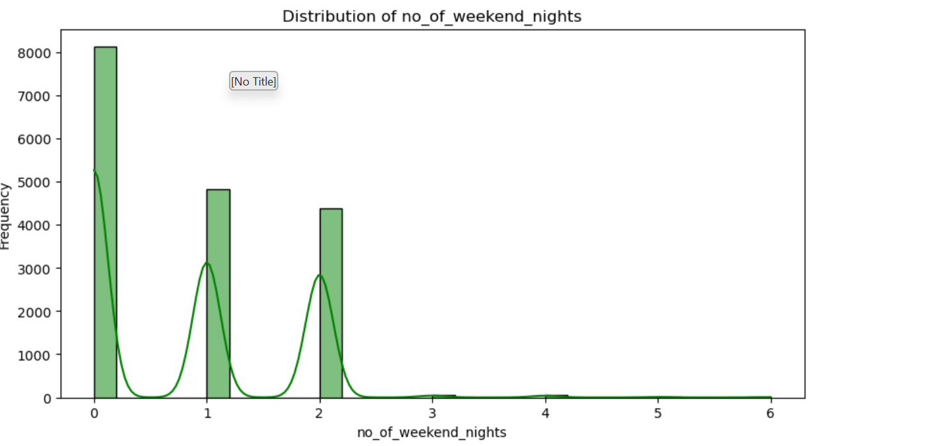
This histogram shows the frequency distribution of ‘no of weekend night' values. The KDE line provides a smoothed estimate of the distribution, making it easier to see the underlying pattern.

Slide 8
MODEL EVALUATION
By looking at all the models that are created the best scores are obtained by the models are Decision Tree, Random Forest, KNN, Naïve Bayes, Gradient Boosting and XGBClassifier. The model we selected among these is Random Forest Classifier.
MODELS | TRAIN SCORE | TEST SCORE | Cross -validated
LogisticRegression | 0.761 | 0.760 | 0.775
DecisionTreeClassifier | 1.0 | 0.818 | 0.840
RandomForestClassifier | 0.999 | 0.874 | 0.885
KNeighborsClassifier | 0.801 | 0.718 | 0.678
Support Vector Mechanism (SVM) | Linear:0.784 | Linear:0.790 | null
Naïve Bayes(GaussianNB) | 0.510 | 0.513 | 0.558
AdaBoostClassifier | 0.364 | 0.368 | 0.803
GradientBoostingClassifier | 0.794 | 0.792 | 0.849
XGBClassifier | 0.949 | 0.867 | 0.868

Slide 9
Best model= RANDOM FOREST
Random forest best parameters;{'params':{‘n_estimators':[5],'max_depth’: [20] }}
Random forest cross-validated best score:0.876585
Random forest test accuracy:0.86095

Slide 10
FUTURE WORKS
Reduced Overbooking: By predicting cancellations, hotels can reduce overbooking and minimize the number of guests who need to be relocated.
Optimized Room Allocation: Hotels can allocate rooms more efficiently, reducing the need for last-minute room changes.
Better Resource Management: Hotels can manage their resources, such as staff and amenities, more effectively.

Slide 11
Conclusion:
This project aims to develop a machine learning model that can predict the likelihood of a hotel reservation being canceled. By using machine learning algorithms, we can develop a model that can provide accurate predictions and help hotel managers reduce the likelihood of bookings being canceled.

